Slide 1
ULP: User Language Programs
Tianxiao

Slide 2
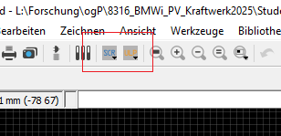
ULP
What’s ULP
User defined scripts that can do some automatic works
Download from Autodesk ULP center or write by yourself
Usage
Download the ULP you need
Click ULP ion
Select the ULP to use

Slide 3
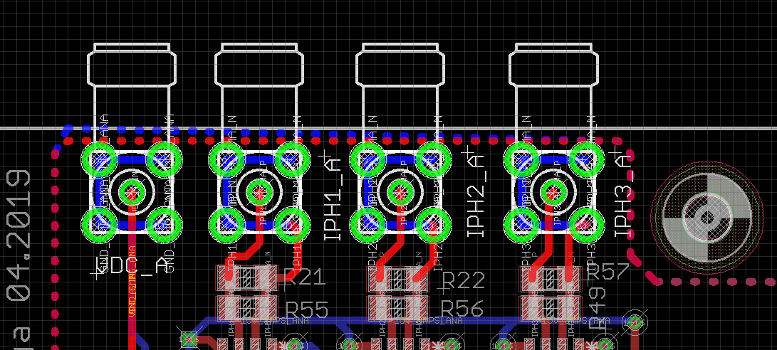
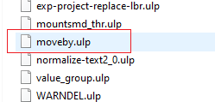
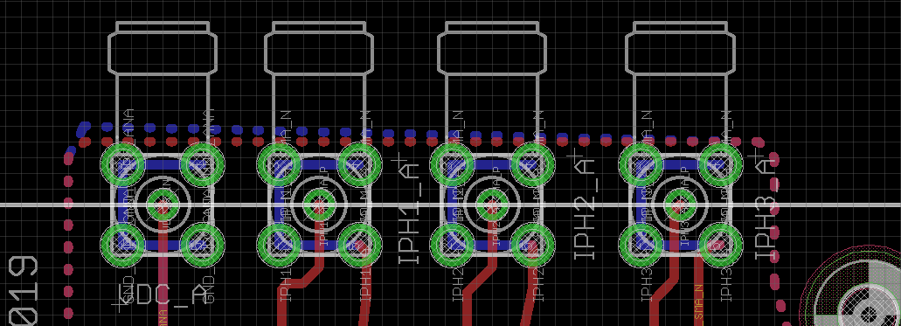
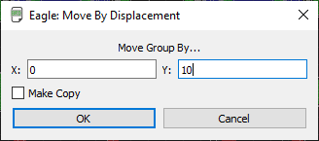
ULP
Example
Move group components with specific distance
Select a group
Click ulp ion
Run moveby.ulp
Give distance values
Components are moved

Slide 4
ULP
ULP center
Find more ulp at ulp center
http://eagle.autodesk.com/eagle/ulp?utf8=%E2%9C%93&q%5Btitle_or_author_or_description_cont%5D=&button=

